Slide 1

Task-based LU factorization on Multicore Processors
Hartwig Anzt, hartwig.anzt@kit.edu

Slide 2
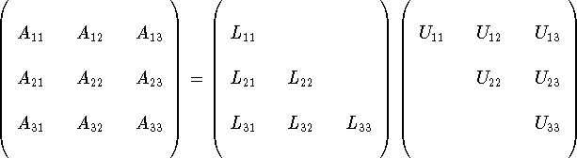
Solving linear problems with the Gauss algorithm
More efficient:
Factorize the matrix into product of
Lower triangular matrix L
Upper triangular matrix U
Solve triangular systems for RHS
Hartwig Anzt, hartwig.anzt@kit.edu

Slide 3
Matrix Factorization Algorithms
Product of:
Lower triangular matrix L
Upper triangular matrix U
L unit diagonal
LU factorization
Factor A into product:
Hartwig Anzt, hartwig.anzt@kit.edu

Slide 4
Matrix Factorization Algorithms
Product of:
Lower triangular matrix L
Upper triangular matrix U
L unit diagonal
LU factorization
Factor A into product:
Cholesky factorization
Factor A into product:
Lower triangular matrix L
Transpose of L
Works for SPD systems
Hartwig Anzt, hartwig.anzt@kit.edu

Slide 5
Matrix Factorization Algorithms
Product of:
Lower triangular matrix L
Upper triangular matrix U
L unit diagonal
LU factorization
Factor A into product:
Cholesky factorization
Factor A into product:
Lower triangular matrix L
Transpose of L
Works for SPD systems
QR factorization
Factor A into product:
Non-square A
num_rows> num_cols
Hartwig Anzt, hartwig.anzt@kit.edu

Slide 6
LU Factorization
Product of:
Lower triangular matrix L
Upper triangular matrix U
U
LU factorization
Factor A into product:
L
Convention: L has 1 on the main diagonal
Hartwig Anzt, hartwig.anzt@kit.edu

Slide 7
LU Factorization
Product of:
Lower triangular matrix L
Upper triangular matrix U
LU factorization
Factor A into product:
Hartwig Anzt, hartwig.anzt@kit.edu

Slide 8
LU Factorization
Product of:
Lower triangular matrix L
Upper triangular matrix U
LU factorization
Factor A into product:
Hartwig Anzt, hartwig.anzt@kit.edu

Slide 9
LU Factorization
Product of:
Lower triangular matrix L
Upper triangular matrix U
LU factorization
Factor A into product:
Hartwig Anzt, hartwig.anzt@kit.edu

Slide 10
LU Factorization
Product of:
Lower triangular matrix L
Upper triangular matrix U
LU factorization
Factor A into product:
Hartwig Anzt, hartwig.anzt@kit.edu

Slide 11
Excursion: Pivoting for numerical stability
Bring in every LU step the largest element in row/column on the diagonal.
Needed for numerical stability
Extremely expensive (Synchronization & Communication)
Variants: Row-Pivoting, Column-Pivoting, Full Pivoting…
Hartwig Anzt, hartwig.anzt@kit.edu

Slide 12
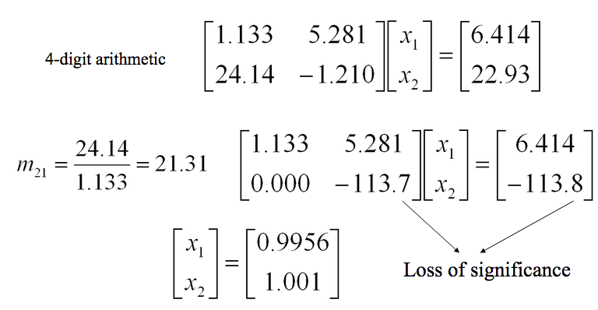
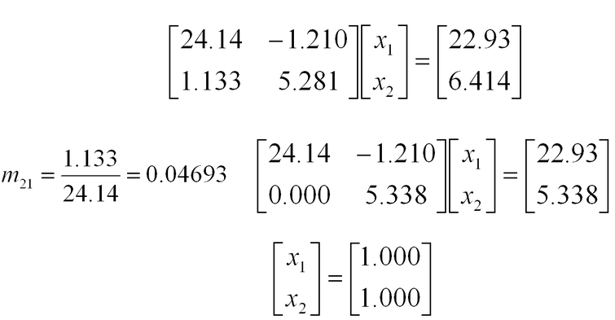
Excursion: Pivoting for numerical stability
Bring in every LU step the largest element in row/column on the diagonal.
Needed for numerical stability
Extremely expensive (Synchronization & Communication)
Variants: Row-Pivoting, Column-Pivoting, Full Pivoting…
Hartwig Anzt, hartwig.anzt@kit.edu

Slide 13
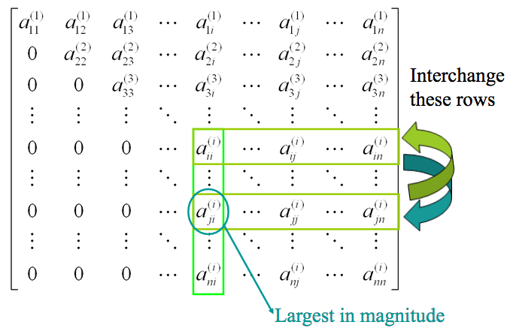
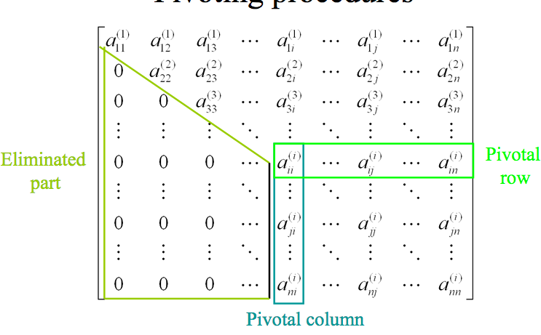
Excursion: Pivoting for numerical stability
Bring in every LU step the largest element in row/column on the diagonal.
Needed for numerical stability
Extremely expensive (Synchronization & Communication)
Variants: Row-Pivoting, Column-Pivoting, Full Pivoting…
Row-Pivoting
Hartwig Anzt, hartwig.anzt@kit.edu

Slide 14
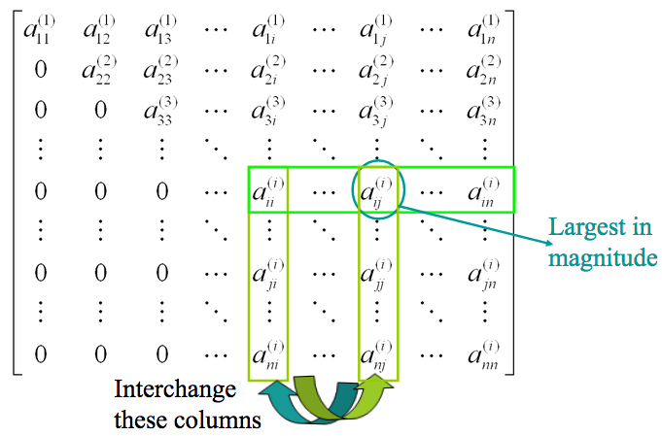
Excursion: Pivoting for numerical stability
Bring in every LU step the largest element in row/column on the diagonal.
Needed for numerical stability
Extremely expensive (Synchronization & Communication)
Variants: Row-Pivoting, Column-Pivoting, Full Pivoting…
Column-Pivoting
Hartwig Anzt, hartwig.anzt@kit.edu

Slide 15
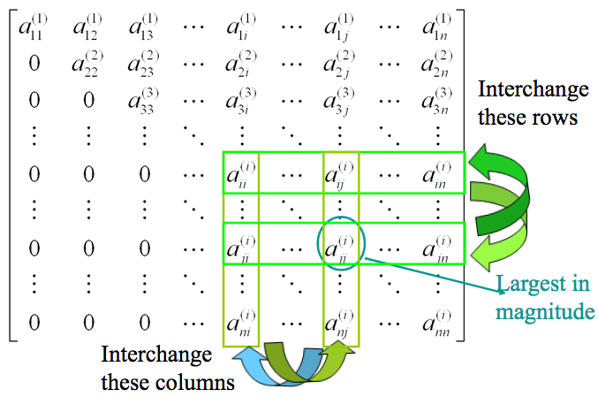
Excursion: Pivoting for numerical stability
Bring in every LU step the largest element in row/column on the diagonal.
Needed for numerical stability
Extremely expensive (Synchronization & Communication)
Variants: Row-Pivoting, Column-Pivoting, Full Pivoting…
Full-Pivoting
Hartwig Anzt, hartwig.anzt@kit.edu

Slide 16
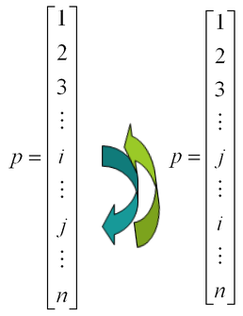
Excursion: Pivoting for numerical stability
Bring in every LU step the largest element in row/column on the diagonal.
Needed for numerical stability
Extremely expensive (Synchronization & Communication)
Variants: Row-Pivoting, Column-Pivoting, Full Pivoting…
Storing pivot information
in integer vector
Hartwig Anzt, hartwig.anzt@kit.edu

Slide 17
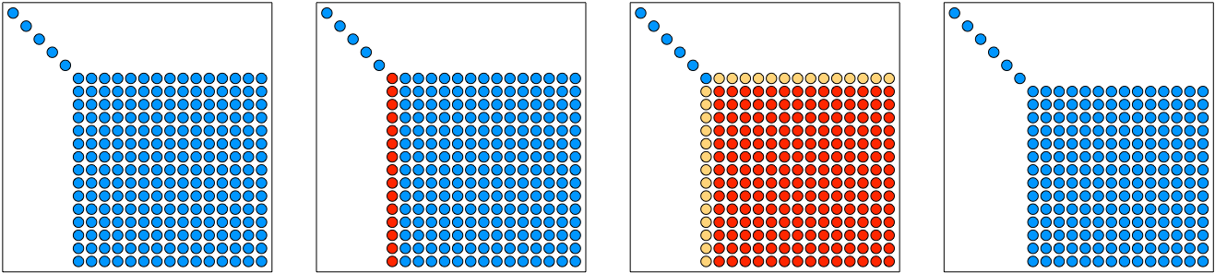
Scalar LU factorization
Product of:
Lower triangular matrix L
Upper triangular matrix U
LU factorization
Factor A into product:
Hartwig Anzt, hartwig.anzt@kit.edu

Slide 18
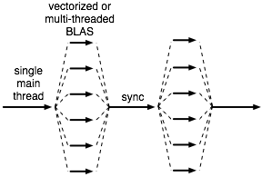
Scalar LU factorization
Product of:
Lower triangular matrix L
Upper triangular matrix U
LU factorization
Factor A into product:
Factor one column at a time (max and scal)
Update each column of trailing matrix, one column at a time (axpy)
Level 1 BLAS
Bulk synchronous
Single main thread
Parallel work in BLAS
“Fork-and-join” model
Hartwig Anzt, hartwig.anzt@kit.edu

Slide 19
Scalar LU factorization
Product of:
Lower triangular matrix L
Upper triangular matrix U
LU factorization
Factor A into product:
Factor one column at a time (max and scal)
Update each column of trailing matrix, one column at a time (axpy)
Level 1 BLAS
Bulk synchronous
Single main thread
Parallel work in BLAS
“Fork-and-join” model
LINPACK LU
Hartwig Anzt, hartwig.anzt@kit.edu

Slide 20
Hands-on: Implement naiive LU Factorization
Implement a scalar LU factorization (sequential)
Parallelize using OMP parallel for
Analyze the performance
Increase the matrix size
Vary the number of OMP threads and pinning
for(int i=0; i<size; i++) {
for(int j=i+1; j<size; j++) {
A[j*size+i] /= A[i*size+i];
for(int k=i+1; k<size; k++) {
A[j*size+k] -= A[j*size+i] * A[i*size+k];
}
}
}
Hartwig Anzt, hartwig.anzt@kit.edu

Slide 21
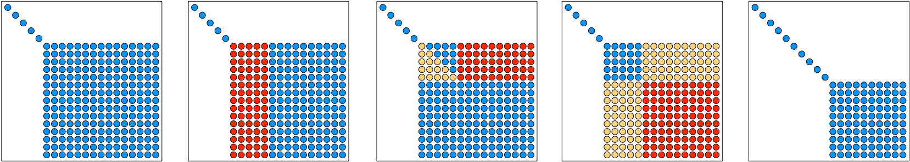
Block LU factorization
Product of:
Lower triangular matrix L
Upper triangular matrix U
LU factorization
Factor A into product:
Factor panel of nb columns
getf2, unblocked BLAS-2 code
Level 3 BLAS update block-row of U
trsm
Level 3 BLAS update trailing matrix
gemm
Aimed at machines with cache hierarchy
Bulk synchronous
Hartwig Anzt, hartwig.anzt@kit.edu

Slide 22
Block LU factorization
Product of:
Lower triangular matrix L
Upper triangular matrix U
LU factorization
Factor A into product:
Factor panel of nb columns
getf2, unblocked BLAS-2 code
Level 3 BLAS update block-row of U
trsm
Level 3 BLAS update trailing matrix
gemm
Aimed at machines with cache hierarchy
Bulk synchronous
LAPACK LU
Hartwig Anzt, hartwig.anzt@kit.edu

Slide 23
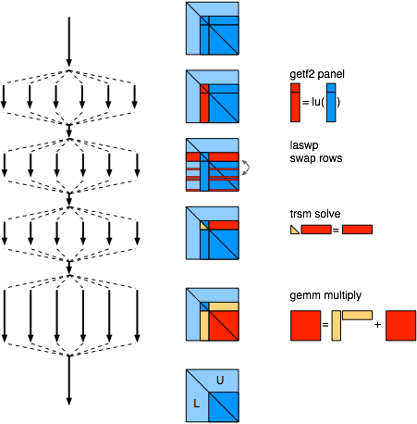
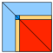
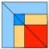
LU Factorization Libraries
 | LINPACK (70s) vector operations | Level 1 BLAS
 | LAPACK (80s) block operations | Level 3 BLAS
All these are Bulk-synchronous (Fork-Join)
Hartwig Anzt, hartwig.anzt@kit.edu

Slide 24
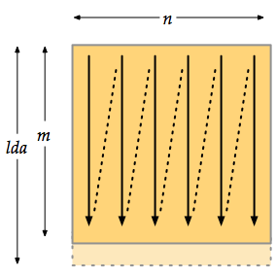
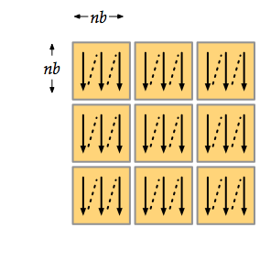
Tile Matrix Layout
LINPACK Layout (column major)
Tile Matrix Layout
Each tile is contiguous (column major)
Enables dataflow scheduling
Cache and TLB efficient (reduces conflict misses and false sharing)
MPI messaging efficiency
Hartwig Anzt, hartwig.anzt@kit.edu

Slide 25
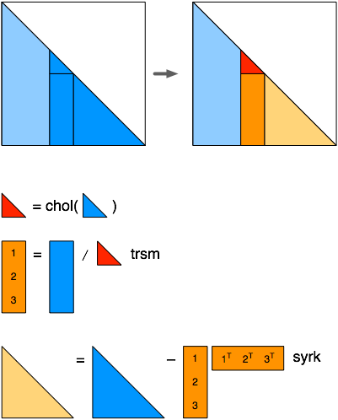
Tile Algorithms: Cholesky
LAPACK Algorithm
Hartwig Anzt, hartwig.anzt@kit.edu

Slide 26
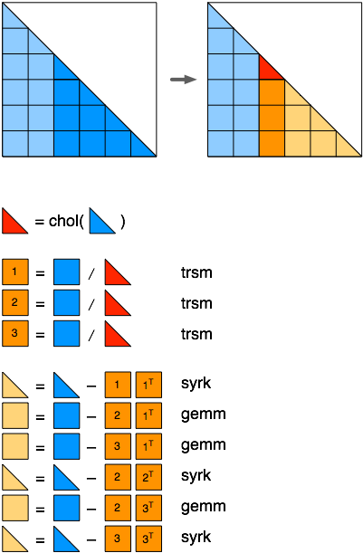
Tile Algorithms: Cholesky
LAPACK Algorithm
Tile Algorithm
Hartwig Anzt, hartwig.anzt@kit.edu

Slide 27
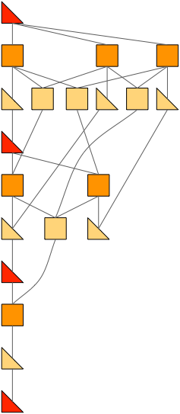
Tile Algorithms: Cholesky
LAPACK Algorithm
Tile Algorithm
Operations on tiles “task”
Track dependencies
-> dependency graph “Directed Acyclic Graph” (DAG)
Hartwig Anzt, hartwig.anzt@kit.edu

Slide 28
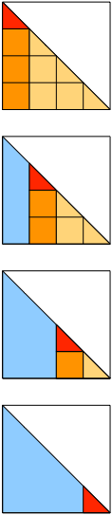
Tile Algorithms: From dependencies to Directed Acyclic Graph
Classical Fork-Join
with synchronizations
Hartwig Anzt, hartwig.anzt@kit.edu

Slide 29
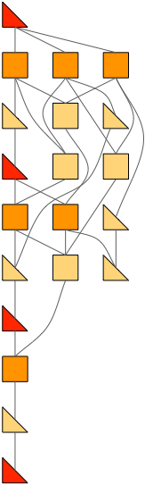
Tile Algorithms: From dependencies to Directed Acyclic Graph
Classical Fork-Join
with synchronizations
Reordered for 3 cores
without synchronization
Hartwig Anzt, hartwig.anzt@kit.edu

Slide 30
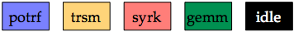
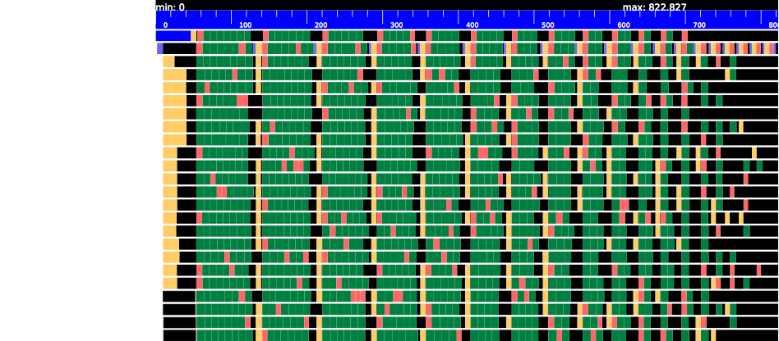
Tile Algorithms: From dependencies to Directed Acyclic Graph
time
24 cores
Matrix is 8,000 x 8,000, tile size is 400 x 400.
Classical Fork-Join
with synchronizations
Hartwig Anzt, hartwig.anzt@kit.edu

Slide 31
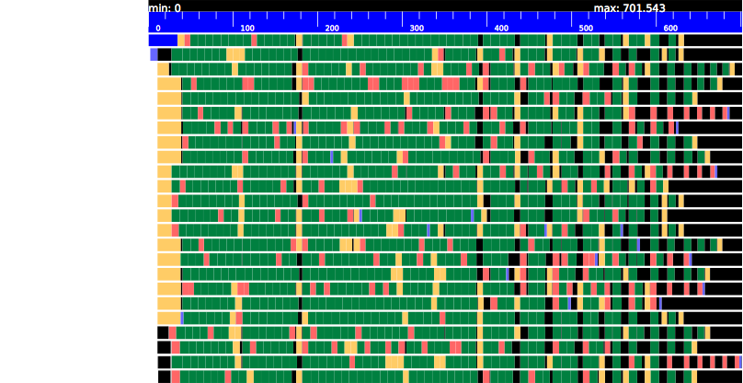
Tile Algorithms: From dependencies to Directed Acyclic Graph
time
24 cores
Matrix is 8,000 x 8,000, tile size is 400 x 400.
Tile-Algorithm Scheduling
avoids synchronizations
Hartwig Anzt, hartwig.anzt@kit.edu

Slide 32
OpenMP Tasks: LU-Example
In-Place Factorization of A into:
Lower triangular matrix L
Upper triangular matrix U
for(int i=0; i<size; i++) {
for(int j=i+1; j<size; j++) {
A[j*size+i] /= A[i*size+i];
for(int k=i+1; k<size; k++) {
A[j*size+k] -= A[j*size+i] * A[i*size+k];
}
}
}
Hartwig Anzt, hartwig.anzt@kit.edu

Slide 33
OpenMP Tasks: LU-Example
for(int i=0; i<size; i++) {
for(int j=i+1; j<size; j++) {
A[j*size+i] /= A[i*size+i];
for(int k=i+1; k<size; k++) {
A[j*size+k] -= A[j*size+i] * A[i*size+k];
}
}
}
We want to transform this into a blocked algorithm
LU decomposition of diagonal block
Update the blocks in the row
Update the blocks in the column
Update the trailing matrix
Hartwig Anzt, hartwig.anzt@kit.edu

Slide 34
OpenMP Tasks: LU-Example
This does the job for the diagonal block!
diag_fact( A ) {
for(int i=0; i<size; i++) {
for(int j=i+1; j<size; j++) {
A[j*size+i] /= A[i*size+i];
for(int k=i+1; k<size; k++) {
A[j*size+k] -= A[j*size+i] * A[i*size+k];
}
}
}}
We want to transform this into a blocked algorithm
LU decomposition of diagonal block
Update the blocks in the row
Update the blocks in the column
Update the trailing matrix
Hartwig Anzt, hartwig.anzt@kit.edu
see: http://www.nersc.gov/

Slide 35
OpenMP Tasks: LU-Example
LU decomposition of diagonal block
Update the blocks in the row
Update the blocks in the column
Update the blocks in the trailing matrix
diag_fact( A[i][i] )
row_update( A[i][j], A[i][i] )
col_update( A[j][i], A[i][i] )
trail_update( A[j][k], A[i][k], A[j][i] )
i
Hartwig Anzt, hartwig.anzt@kit.edu
see: http://www.nersc.gov/

Slide 36
OpenMP Tasks: LU-Example
LU decomposition of diagonal block
Update the blocks in the row
Update the blocks in the column
Update the blocks in the trailing matrix
diag_fact( A[i][i] )
row_update( A[i][j], A[i][i] )
col_update( A[j][i], A[i][i] )
trail_update( A[j][k], A[i][k], A[j][i] )
for(int i=0; i<num_blocks; i++) {
diag_fact( A[i][i] );
for(int j=i+1; j<num_blocks; j++)
row_update( A[i][j], A[i][i] );
col_update( A[j][i], A[i][i] );
for(int j=i+1; j<num_blocks; j++) {
for(int k=i+1; k<num_blocks; k++)
trail_update( A[j][k], A[i][k], A[j][i] );
}
}
i
Hartwig Anzt, hartwig.anzt@kit.edu
see: http://www.nersc.gov/

Slide 37
OpenMP Tasks: LU-Example
LU decomposition of diagonal block
Update the blocks in the row
Update the blocks in the column
Update the blocks in the trailing matrix
diag_fact( A[i][i] )
row_update( A[i][j], A[i][i] )
col_update( A[j][i], A[i][i] )
trail_update( A[j][k], A[i][k], A[j][i] )
#pragma omp parallel
for(int i=0; i<num_blocks; i++) {
#pragma omp single
diag_fact( A[i][i] );
#pragma omp for
for(int j=i+1; j<num_blocks; j++)
row_update( A[i][j], A[i][i] );
col_update( A[j][i], A[i][i] );
#pragma omp for
for(int j=i+1; j<num_blocks; j++) {
for(int k=i+1; k<num_blocks; k++)
trail_update( A[j][k], A[i][k], A[j][i] );
}
}
Can not be parallelized: depends on previous step
One thread factors diag. block
All blocks in row/col parallel
All blocks in trailing matrix handled in parallel
Hartwig Anzt, hartwig.anzt@kit.edu
see: http://www.nersc.gov/

Slide 38
OpenMP Tasks: LU-Example
Classical Fork-Join
with synchronizations
#pragma omp parallel
for(int i=0; i<num_blocks; i++) {
#pragma omp single
diag_fact( A[i][i] );
#pragma omp for
for(int j=i+1; j<num_blocks; j++)
row_update( A[i][j], A[i][i] );
col_update( A[j][i], A[i][i] );
#pragma omp for
for(int j=i+1; j<num_blocks; j++) {
for(int k=i+1; k<num_blocks; k++)
trail_update( A[j][k], A[i][k], A[j][i] );
}
}
Synchronization
Synchronization
Synchronization
Hartwig Anzt, hartwig.anzt@kit.edu
see: http://www.nersc.gov/

Slide 39
OpenMP Tasks: LU-Example
Use OpenMP Tasks instead of “parallel for”
#pragma omp parallel
#pragma omp single
for(int i=0; i<num_blocks; i++) {
diag_fact( A[i][i] );
for(int j=i+1; j<num_blocks; j++)
#pragma omp task
row_update( A[i][j], A[i][i] );
#pragma omp task
col_update( A[j][i], A[i][i] );
#pragma omp taskwait
for(int j=i+1; j<num_blocks; j++) {
for(int k=i+1; k<num_blocks; k++)
#pragma omp task
trail_update( A[j][k], A[i][k], A[j][i] );
}
#pragma omp taskwait
}
Hartwig Anzt, hartwig.anzt@kit.edu
see: http://www.nersc.gov/

Slide 40
OpenMP Tasks: LU-Example
Classical Fork-Join
with synchronizations
#pragma omp parallel
#pragma omp single
for(int i=0; i<num_blocks; i++) {
diag_fact( A[i][i] );
for(int j=i+1; j<num_blocks; j++)
#pragma omp task
row_update( A[i][j], A[i][i] );
#pragma omp task
col_update( A[j][i], A[i][i] );
#pragma omp taskwait
for(int j=i+1; j<num_blocks; j++) {
for(int k=i+1; k<num_blocks; k++)
#pragma omp task
trail_update( A[j][k], A[i][k], A[j][i] );
}
#pragma omp taskwait
}
Sequential
Synchronization
Synchronization
Hartwig Anzt, hartwig.anzt@kit.edu
see: http://www.nersc.gov/

Slide 41
OpenMP Tasks: LU-Example
Use OpenMP task dependencies
#pragma omp parallel
#pragma omp single
for(int i=0; i<num_blocks; i++) {
#pragma omp task depend( inout: A[i][i] )
diag_fact( A[i][i] );
for(int j=i+1; j<num_blocks; j++)
#pragma omp task depend( in: A[i][i] ) depend( inout: A[i][j] )
row_update( A[i][j], A[i][i] );
#pragma omp task depend( in: A[i][i] ) depend( inout: A[j][i] )
col_update( A[j][i], A[i][i] );
for(int j=i+1; j<num_blocks; j++) {
for(int k=i+1; k<num_blocks; k++)
#pragma omp task depend( in: A[j][i], A[i][k] ) depend( inout: A[j][k])
trail_update( A[j][k], A[i][k], A[j][i] );
}
#pragma omp taskwait
}
Hartwig Anzt, hartwig.anzt@kit.edu
see: http://www.nersc.gov/

Slide 42
OpenMP Tasks: LU-Example
Every task only waits for specific dependencies – asynchronous execution DAG
#pragma omp parallel
#pragma omp single
for(int i=0; i<num_blocks; i++) {
#pragma omp task depend( inout: A[i][i] )
diag_fact( A[i][i] );
for(int j=i+1; j<num_blocks; j++)
#pragma omp task depend( in: A[i][i] ) depend( inout: A[i][j] )
row_update( A[i][j], A[i][i] );
#pragma omp task depend( in: A[i][i] ) depend( inout: A[j][i] )
col_update( A[j][i], A[i][i] );
for(int j=i+1; j<num_blocks; j++) {
for(int k=i+1; k<num_blocks; k++)
#pragma omp task depend( in: A[j][i], A[i][k] ) depend( inout: A[j][k])
trail_update( A[j][k], A[i][k], A[j][i] );
}
#pragma omp taskwait
}
Hartwig Anzt, hartwig.anzt@kit.edu
see: http://www.nersc.gov/

Slide 43
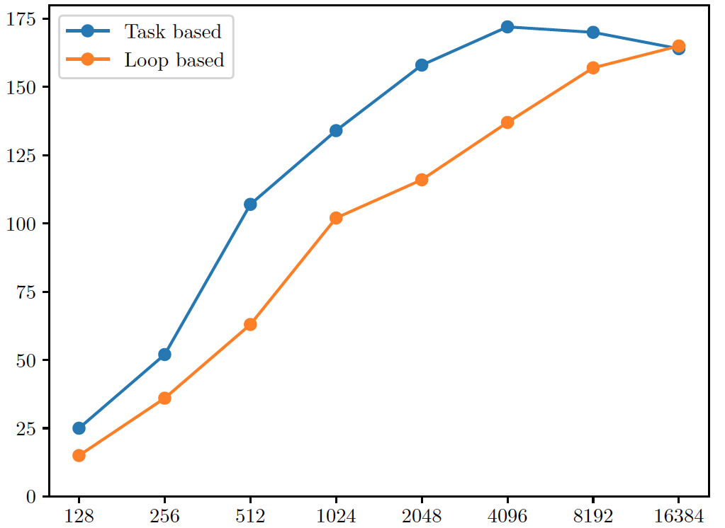
Hands-on: Expand your LU factorization to an OpenMP tile algorithm
Implement the needed building blocks like presented
LU decomposition of diagonal block
Update the blocks in the row
Update the blocks in the column
Update the trailing matrix
Combine the distinct subroutines to form a task-based LU factorization.
In a first step, parallelize using for-loops.
Next, use OMP Tasks
Analyze the performance
Increase the matrix size
Increase the block size
Vary the number of OMP threads and pinning
Compare the performance of “loop-based” vs. “task-based” LU
diag_fact( A[i][i] )
row_update( A[i][j], A[i][i] )
col_update( A[j][i], A[i][i] )
trail_update( A[j][k], A[i][k], A[j][i] )
Performance [GFLOP/s]
Matrix size
Hartwig Anzt, hartwig.anzt@kit.edu

Slide 44
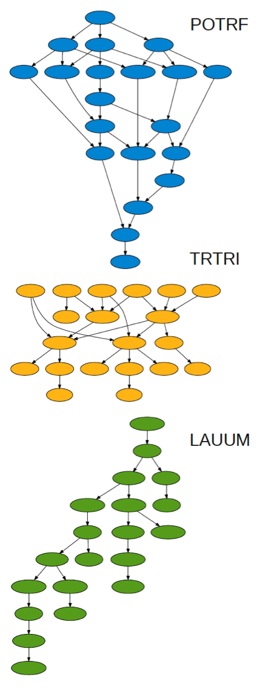
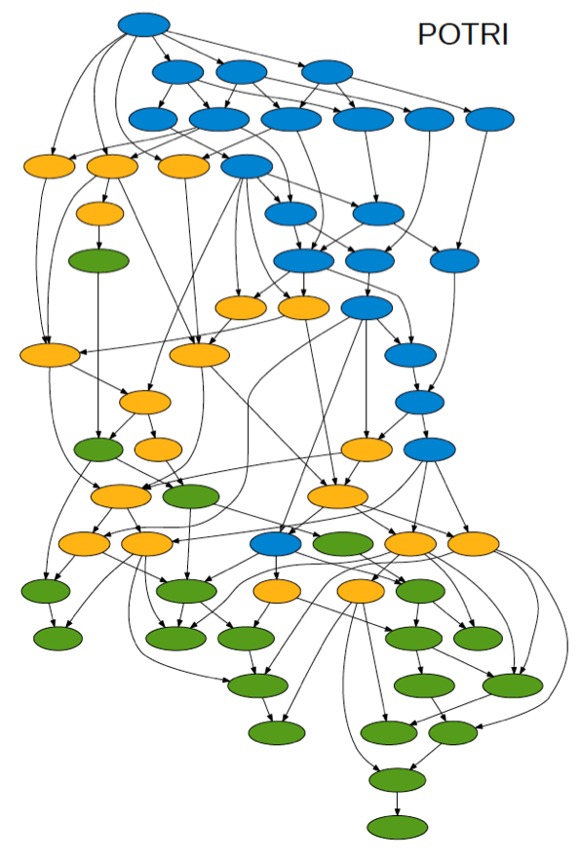
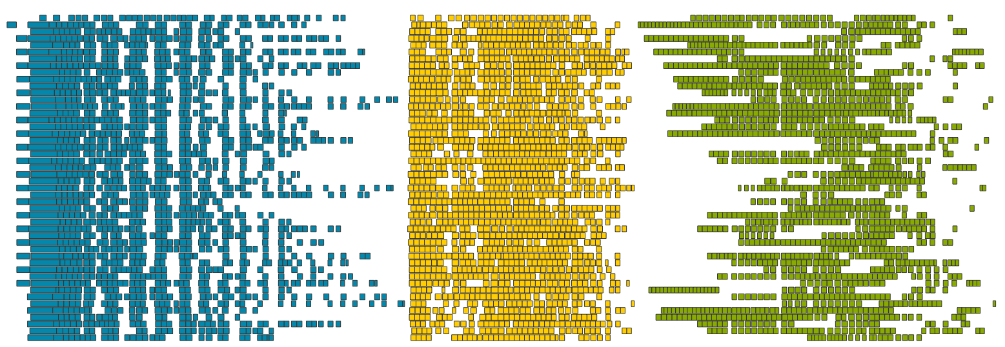
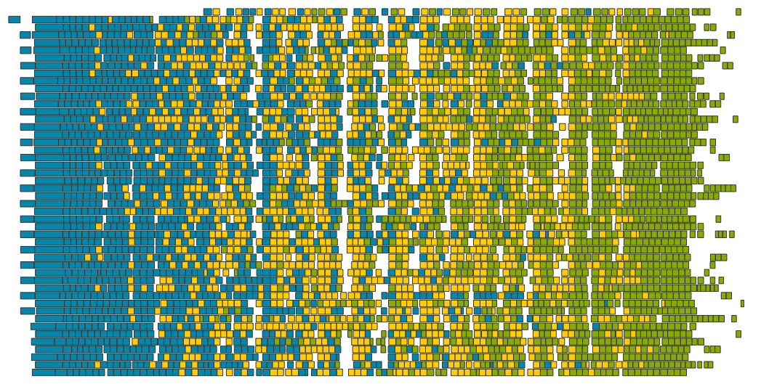
Merging DAGs
48 cores
Matrix is 4,000 x 4,000, tile size is 200 x 200.
Cholesky Inversion
Cholesky A = LL^{T}
time →
Invert L⁻¹
Multiply A⁻¹ = L^{-T} L⁻¹
time →
NOTE: Explicit matrix inversion is usuallly not the method of choice to solve the linear system X = A⁻¹ B.
Hartwig Anzt, hartwig.anzt@kit.edu

